Slide 1
FIFA WORLD CUP ANALYSIS
Prepared by: EJAJ AHAMAD

Slide 2
Introduction
Football is widely famous all over the world and it is an entertaining sport. Many countries participate together and organise word cup events for football. It is very attracting sport for fans. Billions of dollar are collected through these events. Matches are interesting for goals and suspense for energy.
In this project , i am dealing with the data which includes world cup matches, countries participated and players played since 1930-2014. I have gone with data which are important factors for analysis for different factors which are related with this mega event.

Slide 3
Dataset Information
This is a dataset related to the FIFA world cup organized between 1930-2014. The dataset includes World cup matches, countries participated, Players , Cities, Number of goals scored by different countries against different countries, Coach, Attendance and many more data which are represented through visuals in power Bi.

Slide 4
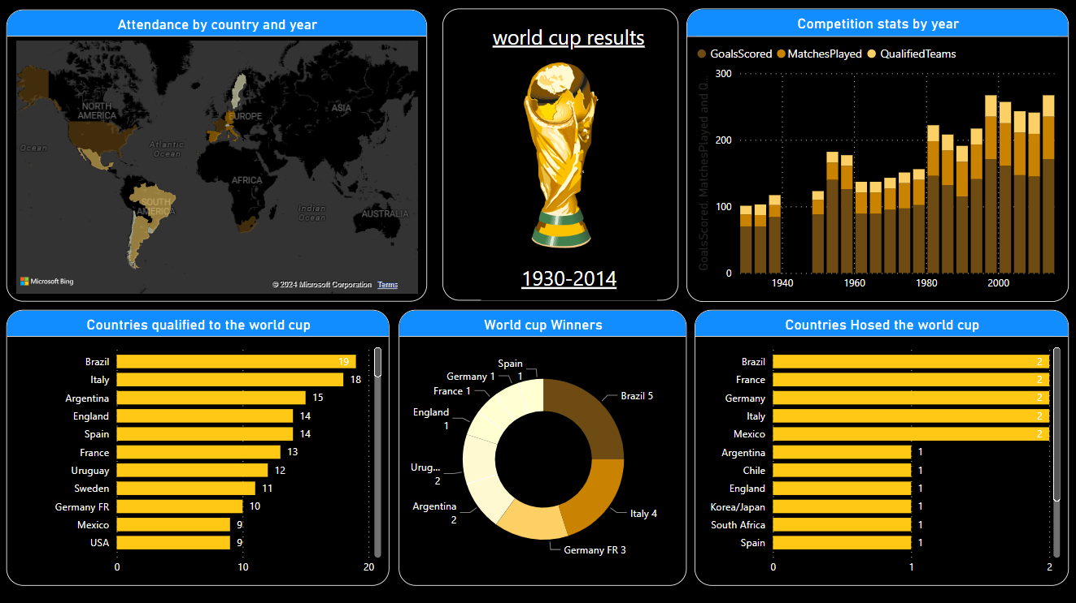
Most number of people attended in 1950 Brazil FIFA world cup which was 1,045,246 .
Most 171 goals were scored in 2014 FIFA world cup.
Brazil has qualified for FIFA world cup most 19 times.
Most number of times winner of FIFA world cup is Brazil . Brazil has won 5 times.

Slide 5
Thank you

